Slide 1
ECE5578 Multimedia Communication: Homework 3 Spring 2020
By Matthew Kayrish

Slide 2
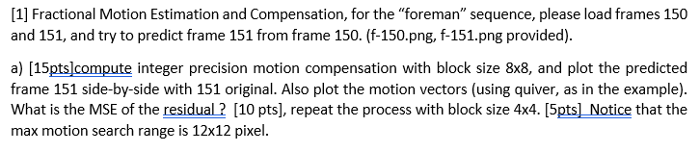
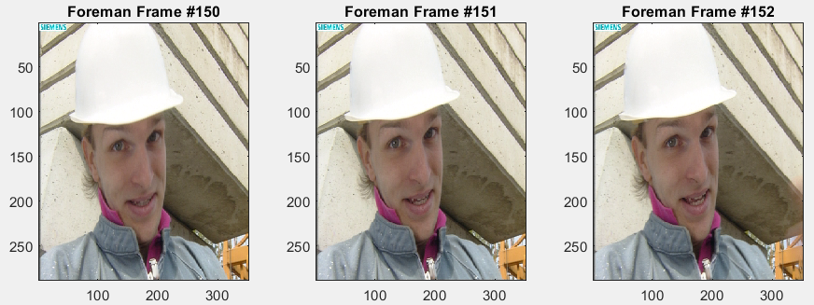
Homework 3: Problem 1 – Introduction

Slide 3
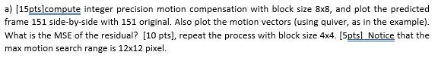
Homework 3: Problem 1.a
TASKS:
Plot the original frames: 150, 151.
Convert the original frames to grayscale.
Load frame 151, create a loop and parse the image into 4x4/8x8 blocks.
Compute the Motion Block Residuals and the Motion Vectors.
Reassemble the Residual Image.
Plot the Quiver Plot.
Compute the MSE of the Residual.
Rerun the Process locking the block size to 4x4.

Slide 4
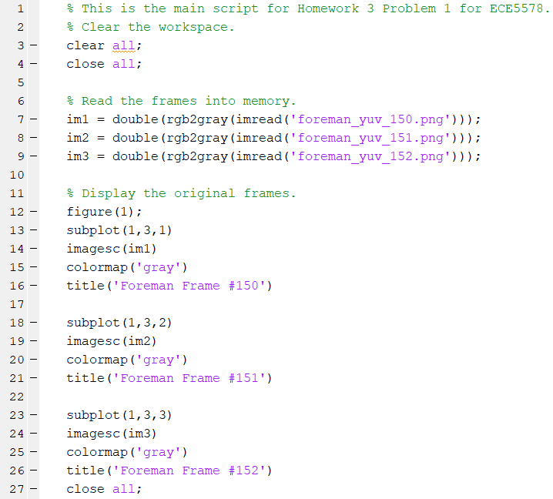
Problem 1.a – Task 1
TASK 1: Plot the original frames: 150, 151.

Slide 5
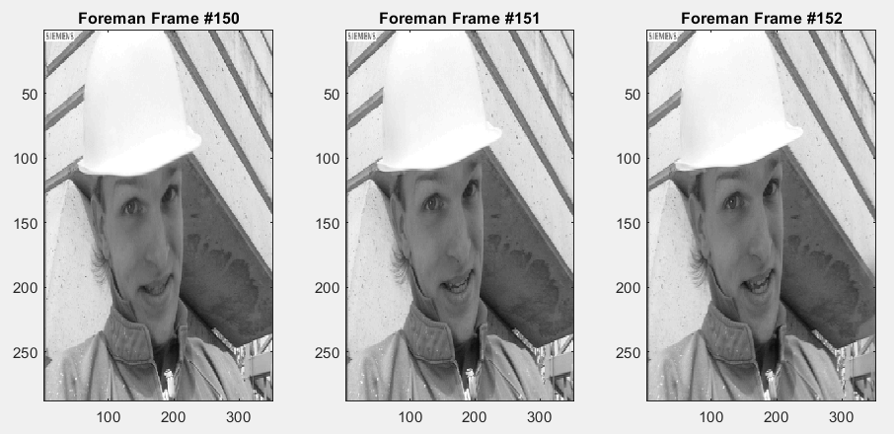
Problem 1.a – Task 2
TASK 2: Convert the original frames to grayscale.

Slide 6
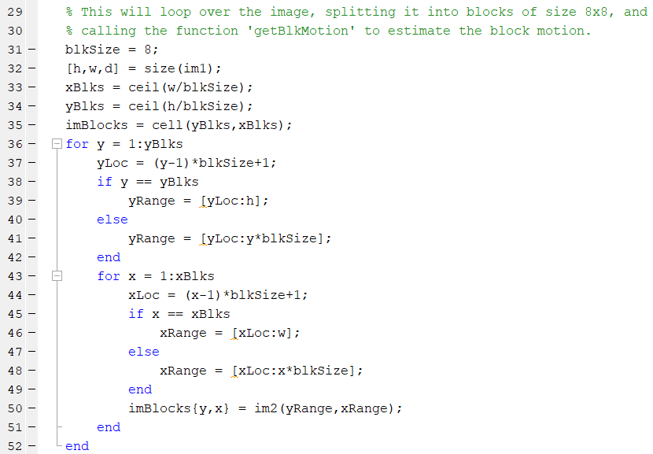
Problem 1.a – Task 3
TASK 3: Load frame 151, and parse into 4x4/8x8 blocks.
Could be set to 4x4 or 8x8 blocks.
Parameter Initialization
Establish the appropriate ‘y’ range.
Establish the appropriate ‘x’ range.
Parse Block by selected size.

Slide 7
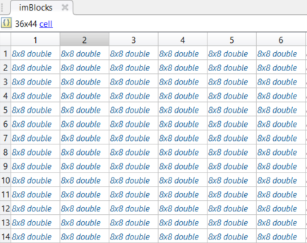
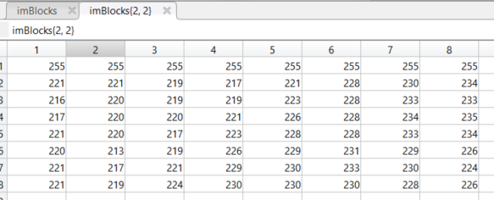
Problem 1.a – Task 3
TASK 3: Load frame 151, and parse into 4x4/8x8 blocks.

Slide 8
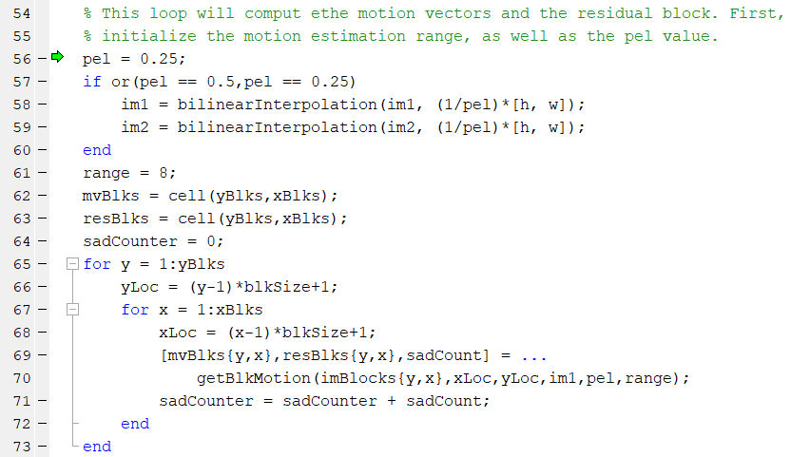
Problem 1.a – Task 4
TASK 4: Compute the Motion Block Vectors and The Residuals.
Custom Function ‘bilinearInterpolation’
Custom Function ‘getBlkMotion’

Slide 9
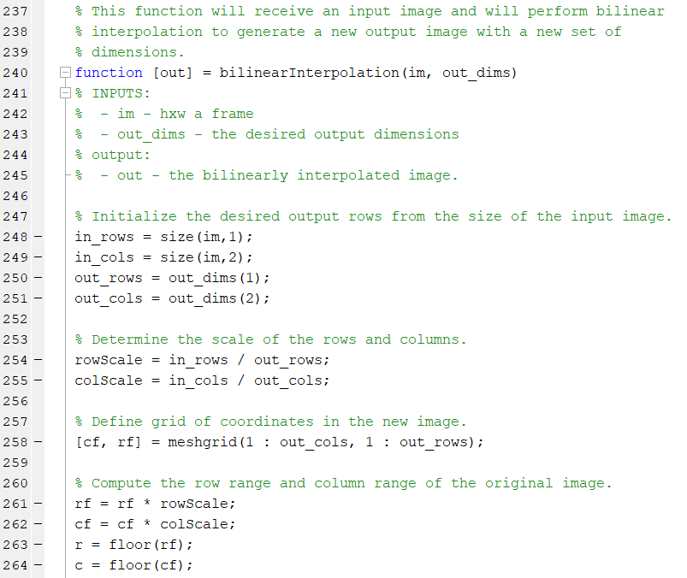
Problem 1.a – Task 4
TASK 4: Compute the Motion Block Vectors and The Residuals.

Slide 10
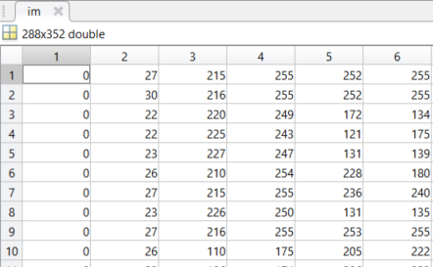
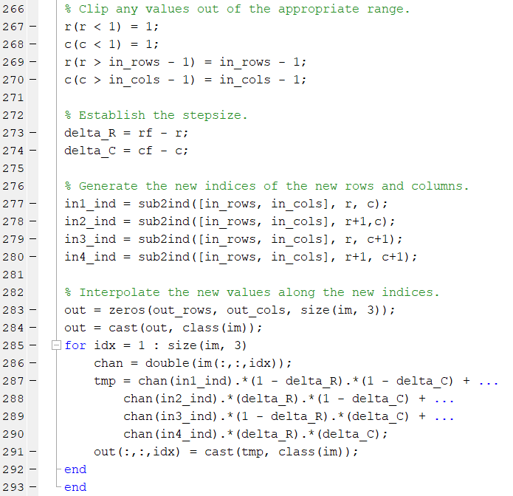
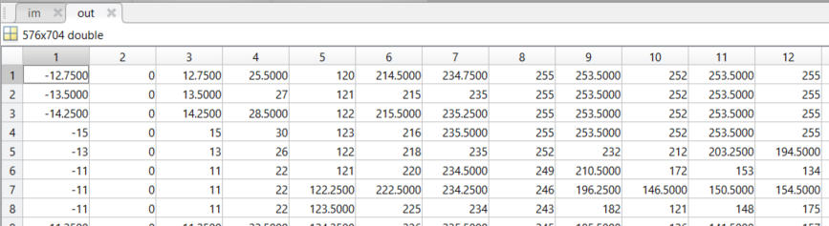
Problem 1.a – Task 4
TASK 4: Compute the Motion Block Vectors and The Residuals.
Input Image Becomes…
…an interpolated output image
with increased dimensions.

Slide 11
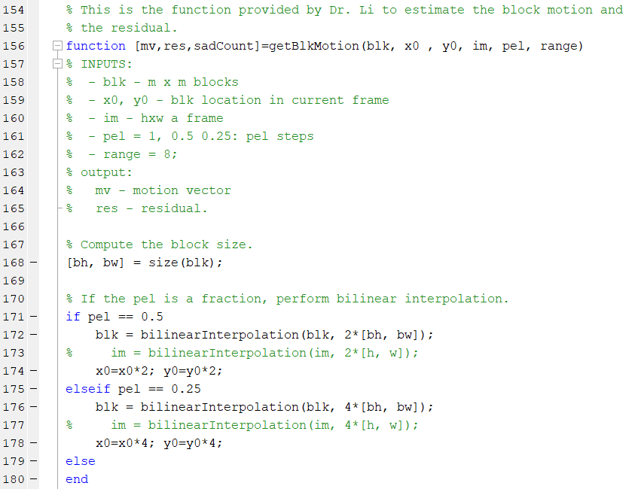
Problem 1.a – Task 4
TASK 4: Compute the Motion Block Vectors and The Residuals.
Interpolate each block if needed.

Slide 12
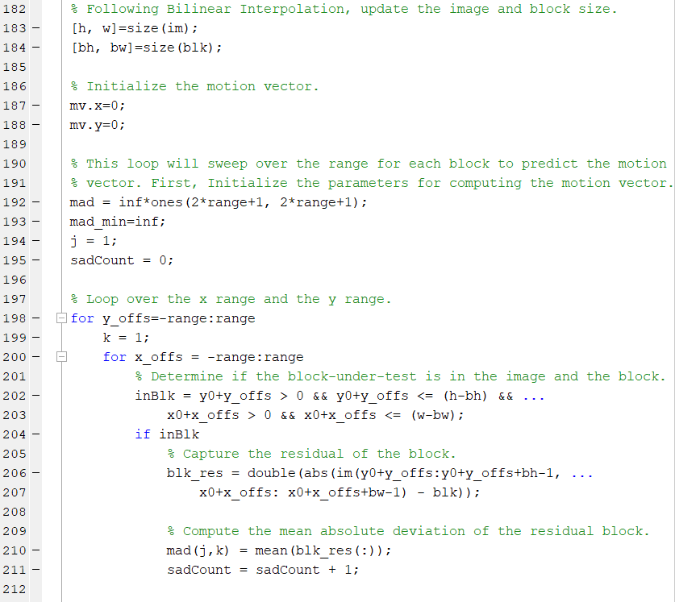
Problem 1.a – Task 4
TASK 4: Compute the Motion Block Vectors and The Residuals.
Initialize parameters.
Compute the residual block
Compute the Mean Absolute
Deviation for each block.

Slide 13
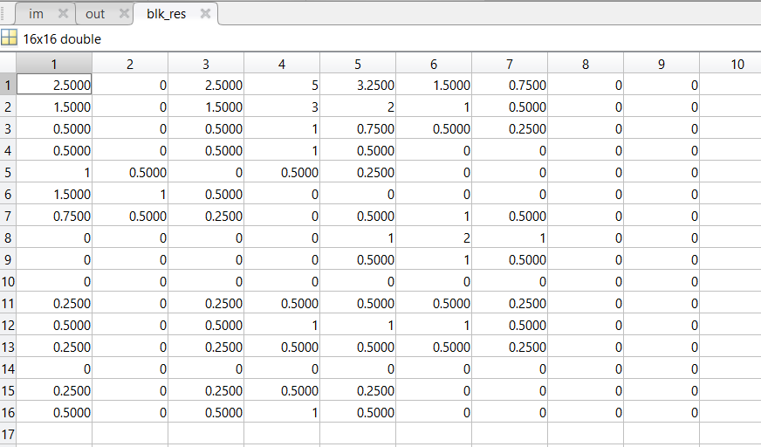
Problem 1.a – Task 4
TASK 4: Compute the Motion Block Vectors and The Residuals.

Slide 14
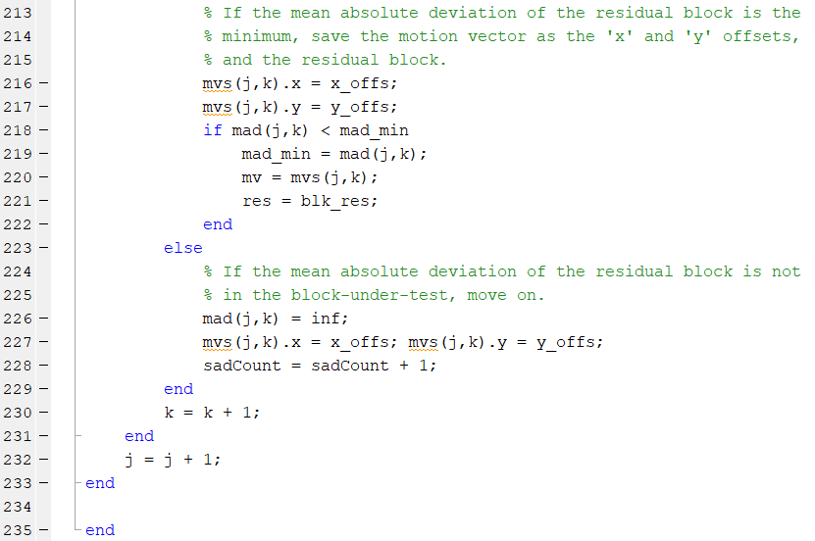
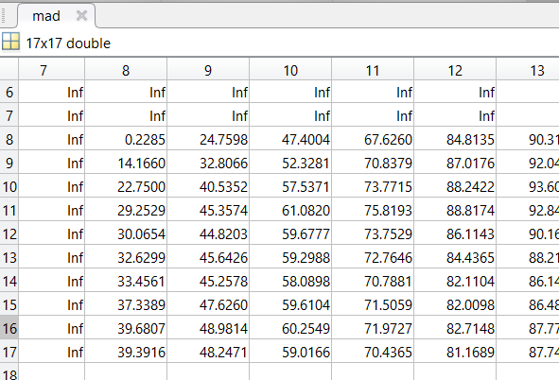
Problem 1.a – Task 4
TASK 4: Compute the Motion Block Vectors and The Residuals.
Generate the MAD for each block. Infinity indicates the MAD
could not be calculated and must be removed. You want the
smallest MAD.

Slide 15
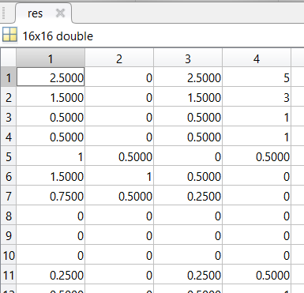
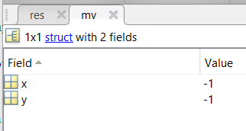
Problem 1.a – Task 4
TASK 4: Compute the Motion Block Vectors and The Residuals.
Residual Blocks
Motion Vectors

Slide 16
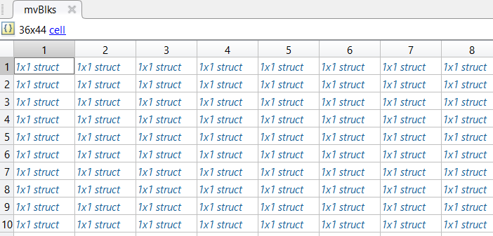
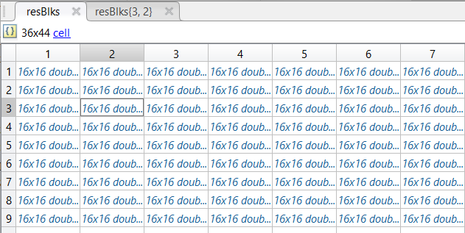
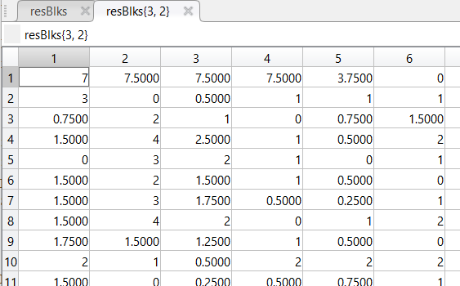
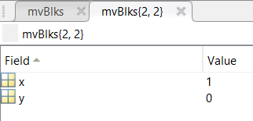
Problem 1.a – Task 4
TASK 4: Compute the Motion Block Vectors and The Residuals.
Cell Array of Motion Vectors
Cell Array of Residual Blocks

Slide 17
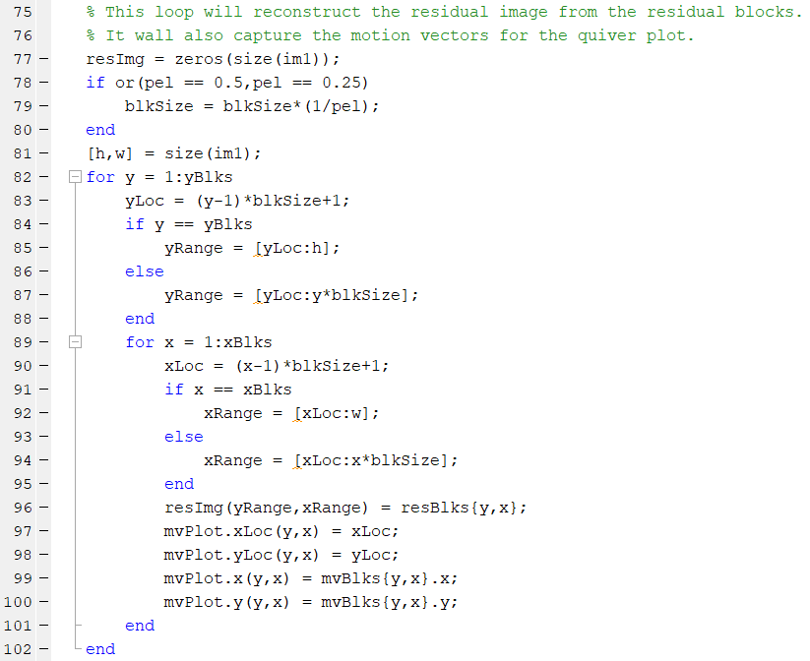
Problem 1.a – Task 5
TASK 5: Reassemble the Residual Image.
Adjust the block size for different pel values.
Determine the ranges for the ‘x’ and ‘y’ coordinates.
Reassemble the residual image.
Extract motion vectors for the quiver plot.

Slide 18
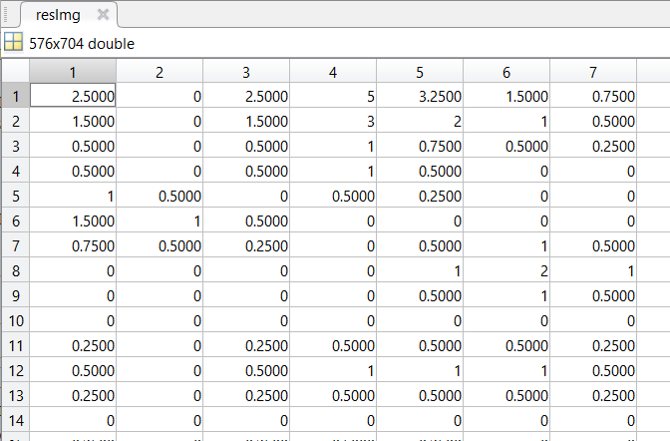
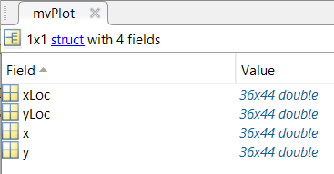
Problem 1.a – Task 5
TASK 5: Reassemble the Residual Image.
Locations
Magnitudes

Slide 19
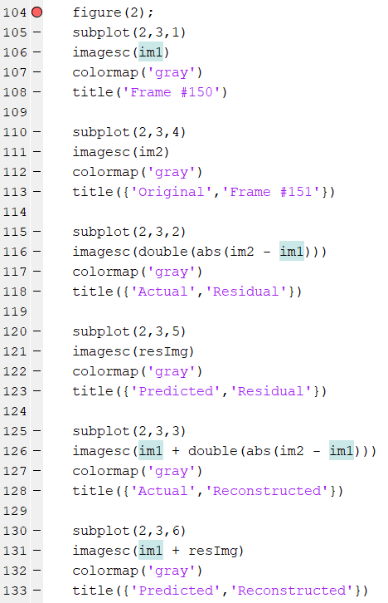
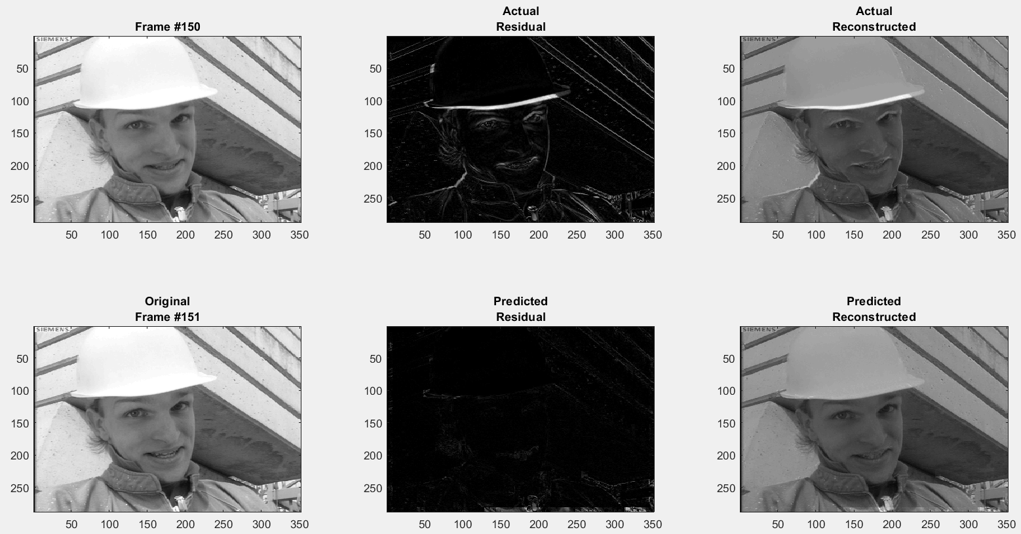
Problem 1.a – Task 5
TASK 5: Reassemble the Residual Image.

Slide 20
Problem 1.a – Task 5
TASK 5: Reassemble the Residual Image.
For this plot, the block size is set to 8x8. The max motion search range is set to 8x8.

Slide 21
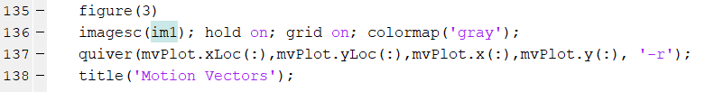
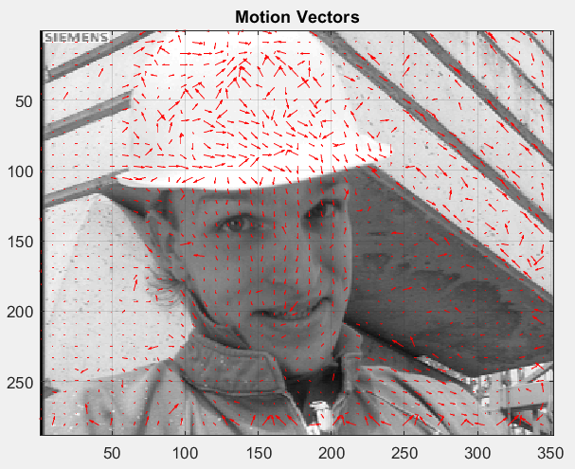
Problem 1.a – Task 6
TASK 6: Plot the Quiver Plot.
For this plot, the block size is set to 8x8. The max motion search range is set to 8x8.

Slide 22
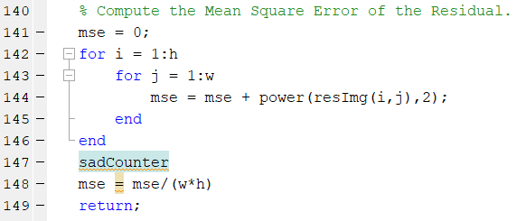
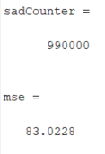
Problem 1.a – Task 7
TASK 7: Compute the MSE of the Residual & Compute the Number of SAD Computations.
MATLAB Output
For this plot, the block size is set to 8x8, the search motion range is 12x12.

Slide 23
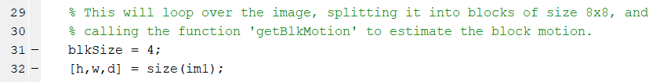
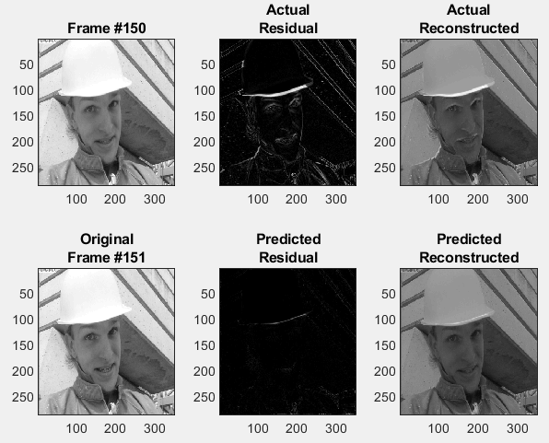
Problem 1.a – Task 8
TASK 8: Repeat the process for 4x4 blocks.
Update the Block Size

Slide 24
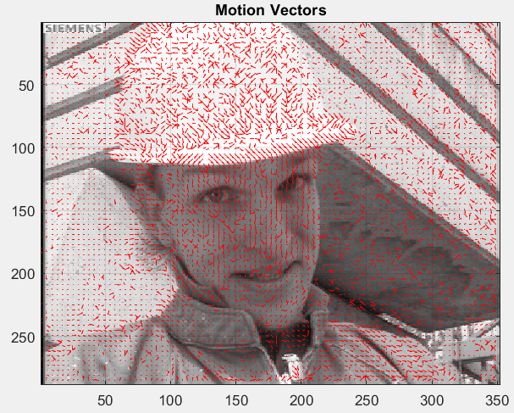
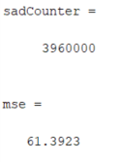
Problem 1.a – Task 8
TASK 8: Repeat the process for 4x4 blocks.
Update the Block Size
MATLAB Output

Slide 25
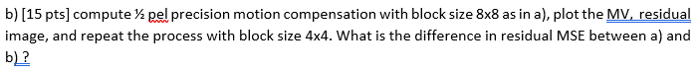
Problem 1.b
TASKS:
Plot the original frames: 150, 151.
Convert the original frames to grayscale.
Load frame 150, create a loop and parse the image into 8x8 blocks.
Perform bilinear interpolation on the input images for the Pel Value.
Compute the Motion Block Residuals and the Motion Vectors.
Reassemble the Residual Image.
Plot the Quiver Plot.
Compute the MSE of the Residual.
Rerun the Process locking the block size to 4x4.
THESE TASKS ARE ESSENTIALLY THE SAME AS PROBLEM 1.a. THE CODE IS NEARLY
IDENTICAL. THE ONLY DIFFERENCE IS UPDATING THE PEL VALUE.
WE WILL SKIP TO TASK 4, THEN SHOW RESULTS!

Slide 26
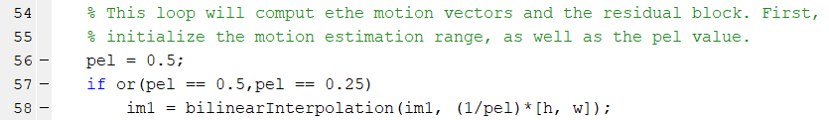
Problem 1.b – Task 4
TASK 8: Perform bilinear interpolation on the input images for the Pel Value.
Update the Pel Value.
Details of Bilinear Interpolation were already discussed during Problem 1.a.
REFER TO SLIDES 9 & 10.
Using a Pel Value of 0.5, the input image size is 288x352.
The output image size is 576x704, EXACTLY DOUBLE THE SIZE

Slide 27
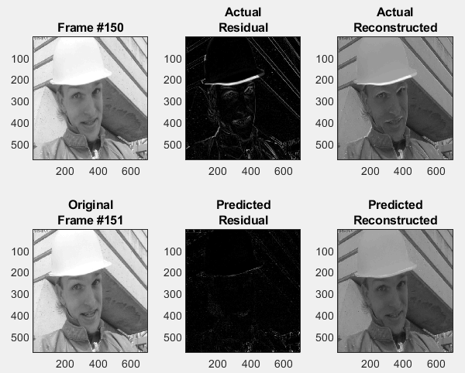
Problem 1.b – Fast Forward to Results
For this plot, the block size is set to 8x8. The max motion search range is set to 12x12.
½ pel precision is used for bilinear interpolation.

Slide 28
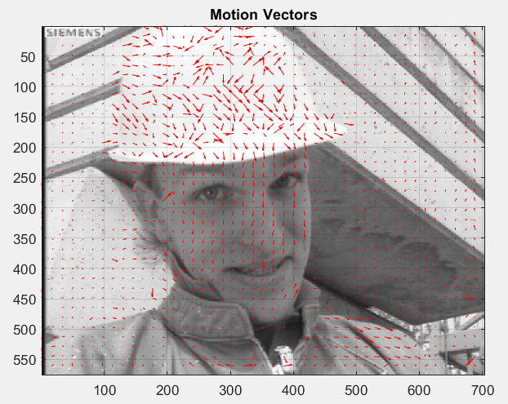
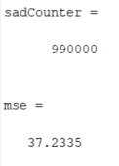
Problem 1.b – Fast Forward to Results
MATLAB Output
For this plot, the block size is set to 8x8. The max motion search range is set to 12x12.
½ pel precision is used for bilinear interpolation.

Slide 29
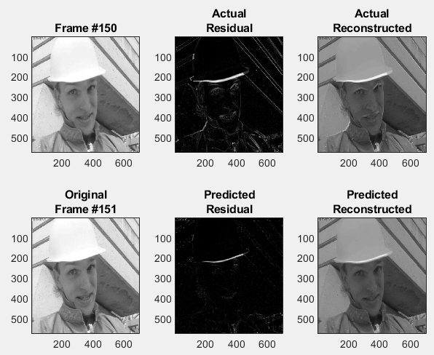
Problem 1.b – Fast Forward to Results
For this plot, the block size is set to 4x4. The max motion search range is set to 12x12.
½ pel precision is used for bilinear interpolation.

Slide 30
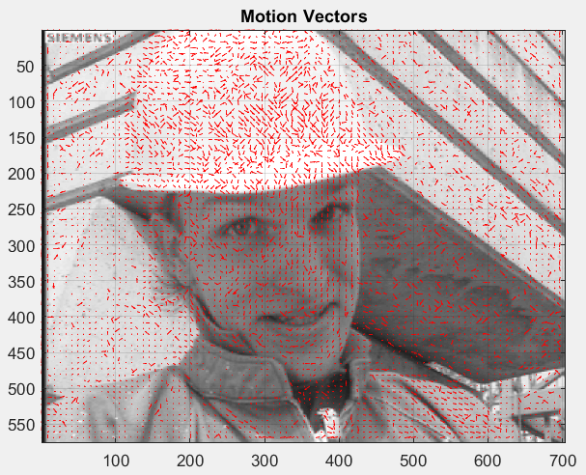
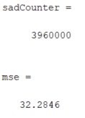
Problem 1.b – Fast Forward to Results
MATLAB Output
For this plot, the block size is set to 4x4. The max motion search range is set to 12x12.
½ pel precision is used for bilinear interpolation.

Slide 31
Problem 1.b – Fast Forward to Results
 | 1 Pel (8x8) | ½ Pel (8x8) | 1 Pel (4x4) | ½ Pel (4x4)
MSE | 83.03 | 37.23 | 61.36 | 32.28
SAD | 990000 | 990000 | 3960000 | 3960000
A MSE decreased fairly significantly when using a 4x4 block when the motion range was
fixed to 12x12. This is because when moving a 4x4 block about a 12x12 range, there are
significantly more residual blocks generated with less values to sum. This increases the
likelihood that the MSE will be smaller.
Because of this reason, there are many more SAD computations. Therefore, the number
increased significantly when decreasing the block size.

Slide 32
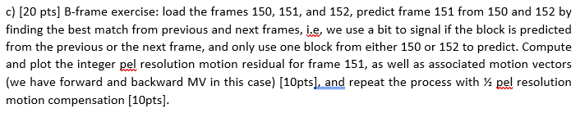
Homework 3: Problem 1.c
TASKS:
Plot the original frames: 150, 151, and 152.
Convert the original frames to grayscale.
Parse image 151 into 8x8 blocks.
Perform bidirectional interpolation on the input images.
Compute the Motion Block Residuals and the Motion Vectors using bi-directional
motion computation.
Reassemble the Residual Image.
Plot the Quiver Plot.
Compute the MSE of the Residual.
Rerun the simulation for ½ pel resolution.
THESE TASKS ARE ESSENTIALLY THE SAME AS PROBLEM 1.a & PROBLEM 1.b.
THE CODE IS NEARLY IDENTICAL. THE ONLY DIFFERENCE IS USING BI-DIRECTIONAL
MOTION COMPUTATION. WE WILL SKIP TO TASK 5, THEN SHOW RESULTS!

Slide 33
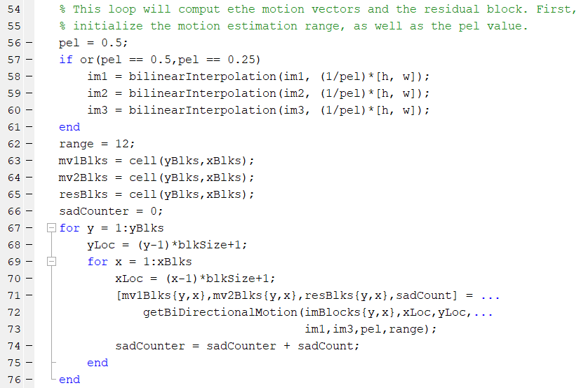
Problem 1.c – Task 5
TASK 5: Compute the Motion Block Residuals and the Motion Vectors using Bi-Directional
Motion Computation.
Custom Function: ‘getBiDirectionalMotion’

Slide 34
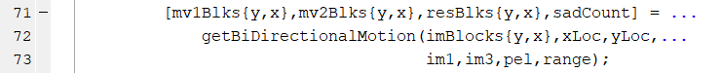
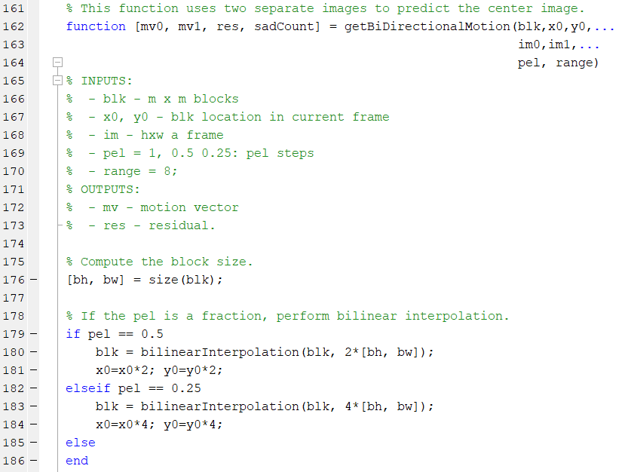
Problem 1.c – Task 5
TASK 5: Compute the Motion Block Residuals and the Motion Vectors using Bi-Directional
Motion Computation.
Again may use bilinear
interpolation if the pel
value changes.

Slide 35
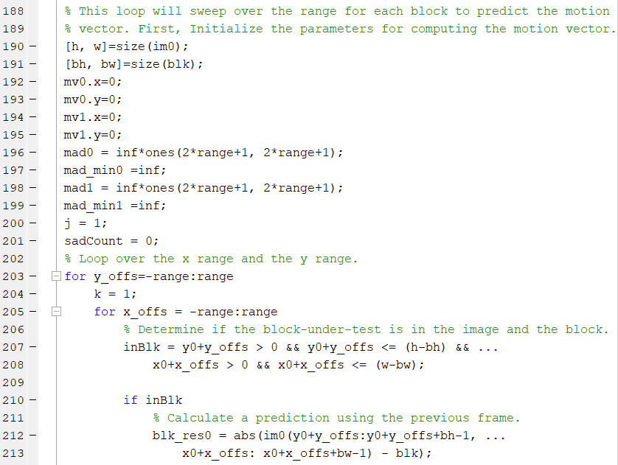
Problem 1.c – Task 5
TASK 5: Compute the Motion Block Residuals and the Motion Vectors using Bi-Directional
Motion Computation.
Initialize two sets of motion vectors and two sets of
MAD matrices.
Determine if a block is applicable.
Compute Residual Block.

Slide 36

Problem 1.c – Task 5
TASK 5: Compute the Motion Block Residuals and the Motion Vectors using Bi-Directional
Motion Computation.
There are two sets of motion vectors,
two calculations of residual blocks,
two MAD blocks, and two minimum
sets that get saved.

Slide 37

Problem 1.c – Task 5
TASK 5: Compute the Motion Block Residuals and the Motion Vectors using Bi-Directional
Motion Computation.
If the residual block cannot be computed due to
edge conditions, move on.
Average the previous frame and the next frame residual block.

Slide 38

Problem 1.c – Fast Forward to Results
For this plot, the block size is set to 8x8. The max motion search range is set to 12x12.
1 pel integer precision.

Slide 39


Problem 1.c – Fast Forward to Results
MATLAB Output
For this plot, the block size is set to 8x8. The max motion search range is set to 12x12.
1 pel integer precision.

Slide 40

Problem 1.c – Fast Forward to Results
For this plot, the block size is set to 8x8. The max motion search range is set to 12x12.
½ pel precision is used for bilinear interpolation.

Slide 41


Problem 1.c – Fast Forward to Results
MATLAB Output
For this plot, the block size is set to 8x8. The max motion search range is set to 12x12.
½ pel precision is used for bilinear interpolation.

Slide 42

Problem 1.c – Fast Forward to Results
For this plot, the block size is set to 4x4. The max motion search range is set to 12x12.
1 pel integer precision.

Slide 43


Problem 1.c – Fast Forward to Results
MATLAB Output
For this plot, the block size is set to 4x4. The max motion search range is set to 12x12.
1 pel integer precision.

Slide 44

Problem 1.c – Fast Forward to Results
For this plot, the block size is set to 4x4. The max motion search range is set to 12x12.
½ pel precision is used for bilinear interpolation.

Slide 45


Problem 1.c – Fast Forward to Results
MATLAB Output
For this plot, the block size is set to 4x4. The max motion search range is set to 12x12.
½ pel precision is used for bilinear interpolation.

Slide 46
Problem 1.c – Fast Forward to Results
 | 1 Pel (8x8) | ½ Pel (8x8) | 1 Pel (4x4) | ½ Pel (4x4)
MSE | 77.06 | 35.80 | 59.18 | 31.92
SAD | 1846312 | 1881250 | 7509408 | 7650312
A MSE decreased fairly significantly when using a 4x4 block when the motion range was
fixed to 12x12. This is because when moving a 4x4 block about a 12x12 range, there are
significantly more residual blocks generated with less values to sum. This increases the
likelihood that the MSE will be smaller.
Because of this reason, there are many more SAD computations. Therefore, the number
increased significantly when decreasing the block size. Additionally, the pel was decreased
which increased the number of computations per block.

Slide 47

Homework 3: Problem 2
TASKS:
Plot the original frames: 150, and 151.
Convert the original frames to grayscale.
Parse image 151 into 8x8 blocks.
Perform bidirectional interpolation on the input images.
Compute the Motion Block Residuals and the Motion Vectors using a Fast Diamond
Algorithm.
Reassemble the Residual Image.
Plot the Quiver Plot.
Compute the MSE of the Residual.
Rerun the simulation for ½ pel resolution.
ONCE AGAIN, THESE TASKS ARE ESSENTIALLY THE SAME FOR THE PREVIOUS.
THE CODE IS NEARLY IDENTICAL. THE ONLY DIFFERENCE IS USING FAST DIAMOND
MOTION COMPUTATION. WE WILL SKIP TO TASK 5, THEN SHOW RESULTS!

Slide 48

Problem 2 – Task 5
TASK 5: Compute the Motion Block Residuals and the Motion Vectors using a Fast Diamond
Algorithm.
Custom Function: ‘getDiamondSearchBlk’

Slide 49

Problem 2 – Task 5
TASK 5: Compute the Motion Block Residuals and the Motion Vectors using Bi-Directional
Motion Computation.
Again may use bilinear
interpolation if the pel
value changes.

Slide 50

Problem 2 – Task 5
TASK 5: Compute the Motion Block Residuals and the Motion Vectors using Bi-Directional
Motion Computation.
Initialize all of the values.
While Loop with a reset each time a new low MAD is found.

Slide 51

Problem 2 – Task 5
TASK 5: Compute the Motion Block Residuals and the Motion Vectors using Bi-Directional
Motion Computation.
Update the Coordinate Location.
Determine if new block
is in acceptable range. If
not, continue.
Compute Residual
Another Condition Check. If the
end of a block exceeds image
limits, continue.

Slide 52

Problem 2 – Task 5
TASK 5: Compute the Motion Block Residuals and the Motion Vectors using Bi-Directional
Motion Computation.
Compute the MAD for the block under
test.
Again, compute residuals,
motion vectors, and save
the minimum MAD.

Slide 53

Problem 2 – Task 5
TASK 5: Compute the Motion Block Residuals and the Motion Vectors using Bi-Directional
Motion Computation.
This is the condition updater for the
Fast Diamond Algorithm. It varies
With each step. The next few slides
Will display the progression as
It calculates updated values.

Slide 54

Problem 2 – Task 5
TASK 5: Compute the Motion Block Residuals and the Motion Vectors using Bi-Directional
Motion Computation.
For Each iteration, we want to watch the
progression of the MAD calculation.
For this example, we will watch
the Fast Diamond process as it
progresses.
- Iteration #1

Slide 55

Problem 2 – Task 5
TASK 5: Compute the Motion Block Residuals and the Motion Vectors using Bi-Directional
Motion Computation.
For Each iteration, we want to watch the
progression of the MAD calculation.
For this example, we will watch
the Fast Diamond process as it
progresses.
- Iteration #2

Slide 56

Problem 2 – Task 5
TASK 5: Compute the Motion Block Residuals and the Motion Vectors using Bi-Directional
Motion Computation.
For Each iteration, we want to watch the
progression of the MAD calculation.
For this example, we will watch
the Fast Diamond process as it
progresses.
- Iteration #3

Slide 57

Problem 2 – Task 5
TASK 5: Compute the Motion Block Residuals and the Motion Vectors using Bi-Directional
Motion Computation.
For Each iteration, we want to watch the
progression of the MAD calculation.
For this example, we will watch
the Fast Diamond process as it
progresses.
- Iteration #4

Slide 58

Problem 2 – Task 5
TASK 5: Compute the Motion Block Residuals and the Motion Vectors using Bi-Directional
Motion Computation.
For Each iteration, we want to watch the
progression of the MAD calculation.
For this example, we will watch
the Fast Diamond process as it
progresses.
- Iteration #5

Slide 59

Problem 2 – Task 5
TASK 5: Compute the Motion Block Residuals and the Motion Vectors using Bi-Directional
Motion Computation.
For Each iteration, we want to watch the
progression of the MAD calculation.
For this example, we will watch
the Fast Diamond process as it
progresses.
- Iteration #6

Slide 60

Problem 2 – Task 5
TASK 5: Compute the Motion Block Residuals and the Motion Vectors using Bi-Directional
Motion Computation.
For Each iteration, we want to watch the
progression of the MAD calculation.
For this example, we will watch
the Fast Diamond process as it
progresses.
- Iteration #7

Slide 61

Problem 2 – Task 5
TASK 5: Compute the Motion Block Residuals and the Motion Vectors using Bi-Directional
Motion Computation.
For Each iteration, we want to watch the
progression of the MAD calculation.
For this example, we will watch
the Fast Diamond process as it
progresses.
- Iteration #8
6.7813 remains the minimum MAD.
Move on to fill in the inner diamond.

Slide 62

Problem 2 – Task 5
TASK 5: Compute the Motion Block Residuals and the Motion Vectors using Bi-Directional
Motion Computation.
For Each iteration, we want to watch the
progression of the MAD calculation.
For this example, we will watch
the Fast Diamond process as it
progresses.
- Iteration #9
Final MAD value: 5.75

Slide 63

Problem 2 – Fast Forward to Results
For this plot, the block size is set to 8x8. The max motion search range is set to 12x12.
1 pel integer precision.

Slide 64


Problem 2 – Fast Forward to Results
MATLAB Output
For this plot, the block size is set to 8x8. The max motion search range is set to 12x12.
1 pel integer precision.

Slide 65

Problem 2 – Fast Forward to Results
For this plot, the block size is set to 8x8. The max motion search range is set to 12x12.
½ pel precision is used for bilinear interpolation.

Slide 66


Problem 2 – Fast Forward to Results
MATLAB Output
For this plot, the block size is set to 8x8. The max motion search range is set to 12x12.
½ pel precision is used for bilinear interpolation.

Slide 67

Problem 2 – Fast Forward to Results
For this plot, the block size is set to 4x4. The max motion search range is set to 12x12.
1 pel integer precision.

Slide 68


Problem 2 – Fast Forward to Results
MATLAB Output
For this plot, the block size is set to 4x4. The max motion search range is set to 12x12.
1 pel integer precision.

Slide 69

Problem 2 – Fast Forward to Results
For this plot, the block size is set to 4x4. The max motion search range is set to 12x12.
½ pel precision is used for bilinear interpolation.

Slide 70


Problem 2 – Fast Forward to Results
MATLAB Output
For this plot, the block size is set to 4x4. The max motion search range is set to 12x12.
½ pel precision is used for bilinear interpolation.

Slide 71
Problem 2 – Fast Forward to Results
 | 1 Pel (8x8) | ½ Pel (8x8) | 1 Pel (4x4) | ½ Pel (4x4)
MSE | 92.64 | 46.38 | 79.86 | 43.83
SAD | 29665 | 34263 | 116227 | 134337
A MSE decreased fairly significantly when using a 4x4 block when the motion range was
fixed to 12x12. This is because when moving a 4x4 block about a 12x12 range, there are
significantly more residual blocks generated with less values to sum. This increases the
likelihood that the MSE will be smaller.
Because of this reason, there are many more SAD computations. Therefore, the number
increased significantly when decreasing the block size. Additionally, the pel was decreased
which increased the number of computations per block.

Slide 72
Problem 2 – Fast Diamond compared to Block Searching
 | 1 Pel (8x8) | ½ Pel (8x8) | 1 Pel (4x4) | ½ Pel (4x4)
MSE | 83.03 | 37.23 | 61.36 | 32.28
SAD | 990000 | 990000 | 3960000 | 3960000
Uni-Directional Block
Motion Estimation
 | 1 Pel (8x8) | ½ Pel (8x8) | 1 Pel (4x4) | ½ Pel (4x4)
MSE | 77.06 | 35.80 | 59.18 | 31.92
SAD | 1846312 | 1881250 | 7509408 | 7650312
Bi-Directional Block
Motion Estimation
 | 1 Pel (8x8) | ½ Pel (8x8) | 1 Pel (4x4) | ½ Pel (4x4)
MSE | 92.64 | 46.38 | 79.86 | 43.83
SAD | 29665 | 34263 | 116227 | 134337
Fast Diamond
Motion Estimation
This shows the comparison of MSE and SAD for uni-directional, bi-directional, and
Fast Diamond Motion Estimation. Based on these results, the Fast Diamond is clearly
Superior in terms of computations compared to the bi-directional and the uni-directional.
The bi-directional performed the worst. This is because it doubles the computations for
Every iteration.

Slide 73
Problem 2 – Fast Diamond compared to Block Searching
 | 1 Pel (8x8) | ½ Pel (8x8) | 1 Pel (4x4) | ½ Pel (4x4)
MSE | 83.03 | 37.23 | 61.36 | 32.28
SAD | 990000 | 990000 | 3960000 | 3960000
Uni-Directional Block
Motion Estimation
 | 1 Pel (8x8) | ½ Pel (8x8) | 1 Pel (4x4) | ½ Pel (4x4)
MSE | 77.06 | 35.80 | 59.18 | 31.92
SAD | 1846312 | 1881250 | 7509408 | 7650312
Bi-Directional Block
Motion Estimation
 | 1 Pel (8x8) | ½ Pel (8x8) | 1 Pel (4x4) | ½ Pel (4x4)
MSE | 92.64 | 46.38 | 79.86 | 43.83
SAD | 29665 | 34263 | 116227 | 134337
Fast Diamond
Motion Estimation
Conclusion:
Decreasing the block size decreases the MSE
Decreasing the block size increases the SAD Computations
Decreasing the Pel value improves performance for both MSE and SAD.

